Slide 1

Site Reliability Engineering (SRE)
The journey starts here..
July 2024

Slide 2
“Site Reliability Engineers must see the system as a whole and treat its interconnections with as much attention and respect as the components themselves”

Slide 3
What is Site Reliability Engineering?
DEFINITION
GOAL
SRE is a discipline that incorporates aspects of software engineering and applies them to infrastructure and operations problems.
SRE is a software engineering practice that uses automation to improve the reliability of software systems.
SRE teams use software tools to perform IT operations tasks, such as: System management, Application monitoring, Change management, Incident response, and Emergency response.
Ensure a reliable, scalable, and efficient service by applying engineering principles to operations tasks.
Serve as a bridge between development teams and operations teams, enabling the development team to bring new software or new features to production as quickly as possible.
Ensure an agreed-upon acceptable level of IT operations performance and error risk in line with the service level agreements (SLAs) the organization has in place with its customers.
Founder: Ben Treynor, VP of Engineering @ Google

Slide 4
History of SRE
First SRE team originated at Google in 2003.
Ben Treynor formed an SRE team to improve the reliability and scalability of the company's sites.
Other leading tech companies, including Netflix and Amazon, soon followed the suit.
Some of the driving factors included:
    Reliability needs (minimal downtime and latency)
    Massive infrastructure
    No DevOps

Slide 5
Core Principles
Reliability
Ensuring the system is dependable and performs well
Incident Management
Quickly resolving and learning from failures
SRE
Scalability
Handling growth in traffic and data gracefully
Efficiency
Optimal use of resources and cost management

Slide 6
DevOps vs SRE
DevOps | SRE
Focuses on the end-to-end application lifecycle | Focuses on delivery and stability of the production environment
All about “what” needs to be done | Talks about “how” it can be done
Reduce organization silos | Share ownership with developers by using the same tools and techniques across the stack
Accept failure as normal | Have a formula for balancing accidents and failures against new releases
Implement gradual change | Encourage moving quickly by reducing costs of failure
Leverage tooling & automation | Encourages automation and minimizing manual work to focus on efforts that bring long-term value to the system
Measure everything | Believes that it’s a software problem, and defines prescriptive ways for measuring availability, uptime, outages, toil, etc.

Slide 7
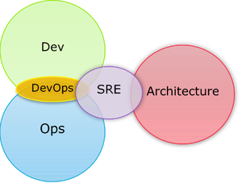
DevOps and SRE
Similarities
SRE and DevOps are more alike than different. Both approaches arose from a desire to enhance the customer experience while building an efficient IT ecosystem. Both SRE and DevOps measure their success using similar metrics, such as the failure rate of newly deployed features.
Working together
SRE and DevOps are not mutually exclusive. They complement each other in their shared aim to deliver quality software faster and more reliably. SRE and DevOps use feedback data from the production environment, often collaboratively, to design improved products and systems.

Slide 8
Key Concepts of SRE
SLO
(Service Level Objectives)
Define acceptable performance levels
SLI
(Service Level Indicators)
Metrics to measure performance
SLA
(Service Level Agreements)
Contracts with customers about service levels
Error Budgets
Balance between release velocity and reliability
Example:
  SLA specifies that your systems will be available 99.95% of the time
  SLO is likely 99.95% uptime or more, but not less than the SLA
  SLI is the actual measurement of your uptime; it could be 99.96% or 99.99%.
An error budget is the maximum amount of time that a technical system can fail without contractual consequences.

Slide 9
Golden Signals of SRE
Saturation
Case for better monitoring:
Focus more on uptime to deduce availability vs user experience
Monitoring system metrics like CPU, memory , storage etc. are good indicators, however, may not be relevant for client experience
Monitor only those metrics (KPIs) that are really required. Ex: MTBF, MTTR
It’s better to monitor metrics such as latency – are the response times taking longer?
Errors
Traffic
Latency

Slide 10
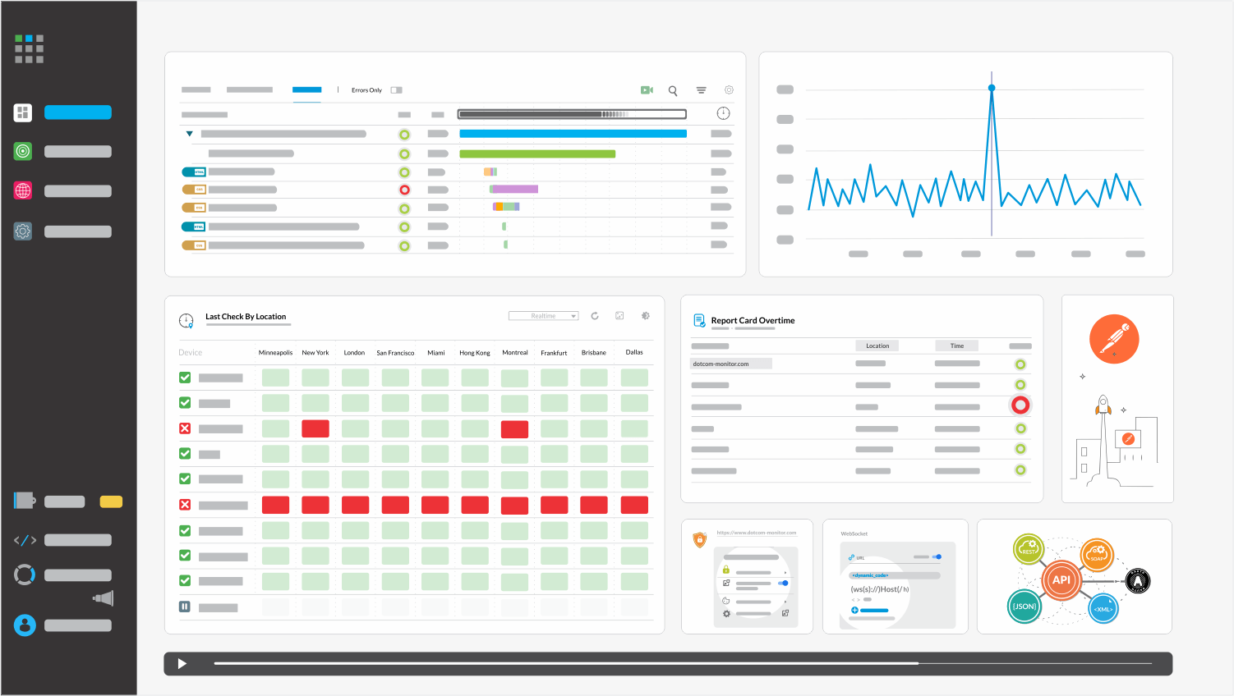
Monitoring
Monitoring is the process of continuously collecting and analyzing data to ensure that systems are functioning as expected. It involves tracking specific metrics and alerts to detect anomalies and issues.
Key characteristics:
  Predefined metrics
  Alerting
  Historical data
  Reactive
Use cases:
  System health checks
  Performance tracking
  Incident detection
Examples of monitoring tools:
  Prometheus
  Nagios
  Datadog

Slide 11

Observability
Observability refers to the ability to understand the internal state of a system based on the external outputs (e.g., logs, metrics, and traces). It involves gaining insights into the system's behavior and diagnosing issues by analyzing various signals.
Key characteristics:
  Metrics
  Events
  Logs
  Traces
  Proactive
Use cases:
  Root Cause Analysis (RCA)
  Debugging
  Performance tuning
Examples of observability tools:
  Grafana
  ELK (Elastic)
  OpenTelemetry

Slide 12
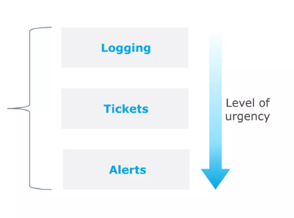
Outputs of a good monitoring system
A carefully crafted monitoring system should be able to distinguish urgent requests from important ones, and only alert when required

Slide 13

Alert design considerations
An alert should only be paged for urgent requests that need immediate attention
Common issues:
Not all alerts are helpful
Alerts are not maintained regularly to keep up with functionality being rolled out
Good practices:
Measure the system along with all parts, but alert only on problems that will cause or is causing end-user pain this helps to reduce “alert fatigue”
Alerts should be actionable

Slide 14
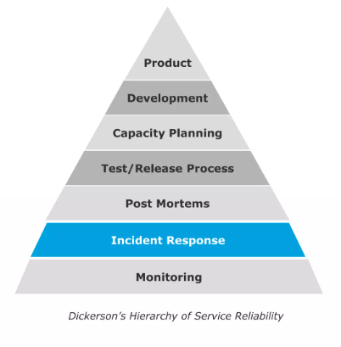
Incident Response
Effective incident response process increases user trust
Users don’t always expect a service to be perfect.
However, they expect their service to be transparent, fast to resolve issues, and learns quickly from mistakes.
Incident Response helps to create that kind of trust when there is a crisis.

Slide 15
Structured Incident Response
People do not typically work well in situations of emergencies. So having a structured incident response process is essential
1
Have sufficient monitoring
2
Good alerting and communication process
3
Playbook-style plans and tools
Sample: https://www.incidentresponse.org/playbooks/improper-computer-usage

Slide 16
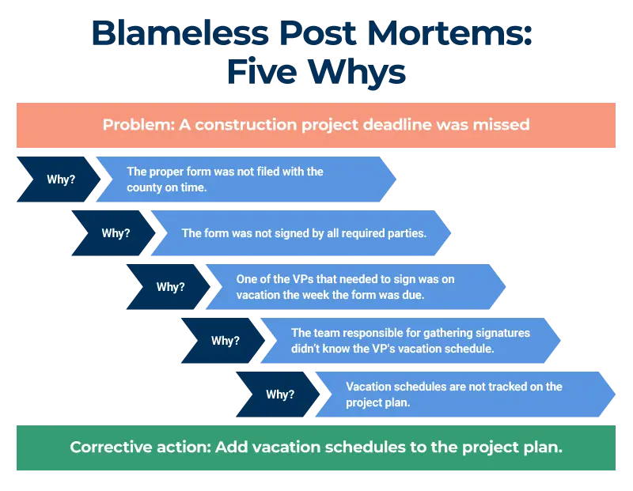
Post-mortems
A post-mortem conducted after an incident helps to build a culture of self-improvement
Goals:
All contributing causes are understood and documented
Action items are put in place to avoid issue repetitions
Good practices:
Post-mortems conducted & closed within 3-5 days after an incident has occurred
Document in detail, the errors, logs, steps taken, and decisions made that led to the incident/outage
Document fixes if an SLO is breached, even if the SLA is not impacted
Conduct blameless post-mortems

Slide 17
SRE: Roles and Responsibilities
System Reliability
Incident Management
Monitoring and Observability
Capacity planning and Scaling
Automation
Design for reliability
Build and maintain SLOs
Error budget management
Incident response
Postmortem analysis
Incident documentation
Monitoring setup
Metrics collection
Alerting
Capacity forecasting
Scaling
Cost management
Task automation
Deployment pipelines
Toil reduction
Performance Optimization
Collaboration and communication
Security and compliance
Continuous Improvement
Emergency response planning
System tuning
Load testing
SLO/SLA management
Cross-functional collaboration
Documentation
Security practices
Compliance
Policies
Process improvement
Training and knowledge sharing
Disaster recovery planning
Business continuity

Slide 18

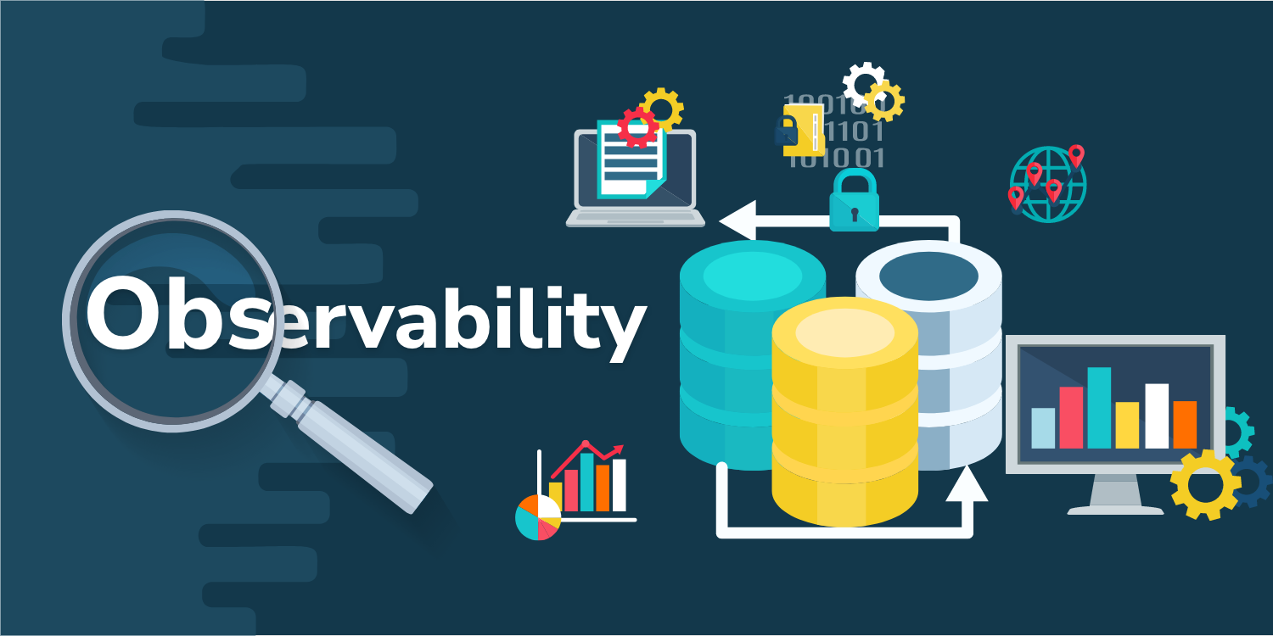
CASE STUDY
Platform assessment followed by profiling enabled the identification of Key Performance Indicators (KPI), Service Level Indicators (SLI), Service Level Objectives (SLO) and alerts.​ Multi-persona observability dashboards built in Grafana with Elasticsearch as data source proved highly beneficial to platform teams. Grafana served as centralized system for all observability needs.
Platform Profiling & Observability Implementation
Retail Manufacturing Company
The customer was maintaining multiple business critical platforms under the same portfolio, but since each platform team used their own monitoring strategy and tools, there was no single-pane-of-glass view, or the observability was not centralized. SLIs and SLOs were not defined, and persona-based dashboards were not available.
75%
50%
15+
Faster identification of errors and latency, traffic, saturation issues
Of human effort reduced to trace and isolate errors
Platforms brought under observability in the first six months

Slide 19
Thank you!

